Slide 1
Final Testing Results
Gore Capstone
22Sp05_GoreIris
Alex Nagle
Skylar Gilmore
Lumini Senaviratne

Slide 2
Design Requirements
Customer Requirment
OSHA Safety
ANSI Safety
Iterative Design Process
Force Readout
Diameter Readout
Cost Control
Reliable
Durable
Engineering Requirement | Target
Start/Stop Button for safety | Does the start/stop button work 100% of the time. For safety.
Iris Style clamp | Does the System crimp the stent as a concentric circle
Iris crimping Diameter from 6mm to 50mm | Can the Iris crimp close to a diameter of at least 6mm
Linear Force Distribution of 28.9 N/cm minimum | Can the motor and the system produce a linear force distribution of at least 28.9 N/cm
User Control of the Force or Diameter | Can the user control the system via touchscreen GUI
GUI Force readout | Can the GUI display the force accurately
GUI Diameter readout | Can the GUI display the Diameter accurately
Under total cost of 3000$ | Is the Cost under the budget

Slide 3
Top Level Testing Summary
Experiment/Test | Relevant DRs | Test Type
Cocentric Crimp Test | ER 2 | Characteristic
Motor rotation Test | CR1, CR2, CR7, ER1 | Quantitative
Motor resistance test | CR8, ER7, | Quantitative
Motor Angular Displacement calculation | CR5, CR7, ER3, ER5, ER7 | Quantitative
Pressure Sensor Force Calibration | CR4, CR7, ER4, ER5, ER6 | Quantitative
Strain Guage Calibration | CR4, CR7, ER4, ER5, ER6 | Quantitative

Slide 4
Spec. Sheet Customer Req
Customer Requirment | CR met? (Y/N) | Client Acceptable (Y/N)
OSHA Safety | Y | Y
ANSI Safety | Y | Y
Iterative Design Process | Y | Y
Force Readout | N | Y
Diameter Readout | Y | Y
Cost Control | Y | Y
Reliable | N | Y
Durable | Y | Y

Slide 5
Spec. Sheet Customer Req
Engineering Requirement | Target | Tolerance | Measured/Calculated value | ER Met? (Y/N) | Client Acceptable (Y/N)
Start/Stop Button for safety | Does the start/stop button work 100% of the time. For safety. | <1% Failure (Does not Stop immediately when pressed) | Yes | Y | Y
Iris Style clamp | Does the System crimp the stent as a concentric circle | Is the Crimp Circle Concentric | Y | Y | Y
Iris crimping Diameter from 6mm to 50mm | Can the Iris crimp close to a diameter of at least 6mm | - .1 mm | 2.5mm – 62 mm | Y | Y
Linear Force Distribution of 28.9 N/cm minimum | Can the motor and the system produce a linear force distribution of at least 28.9 N/cm | +/- .1 N/cm | 28.9N> | Y | Y
User Control of the Force or Diameter | Can the user control the system via touchscreen GUI | <5% Failure |  | Y | Y
GUI Force readout | Can the GUI display the force accurately | +/- .01N | +/-.1N | N | Y
GUI Diameter readout | Can the GUI display the Diameter accurately | +/- .01cm | +/-1.mm | Y | Y
Under total cost of 3000$ | Is the Cost under the budget | Under 3000$ | 2500 | Y | Y
Notes:
Linear force distribution

Slide 6
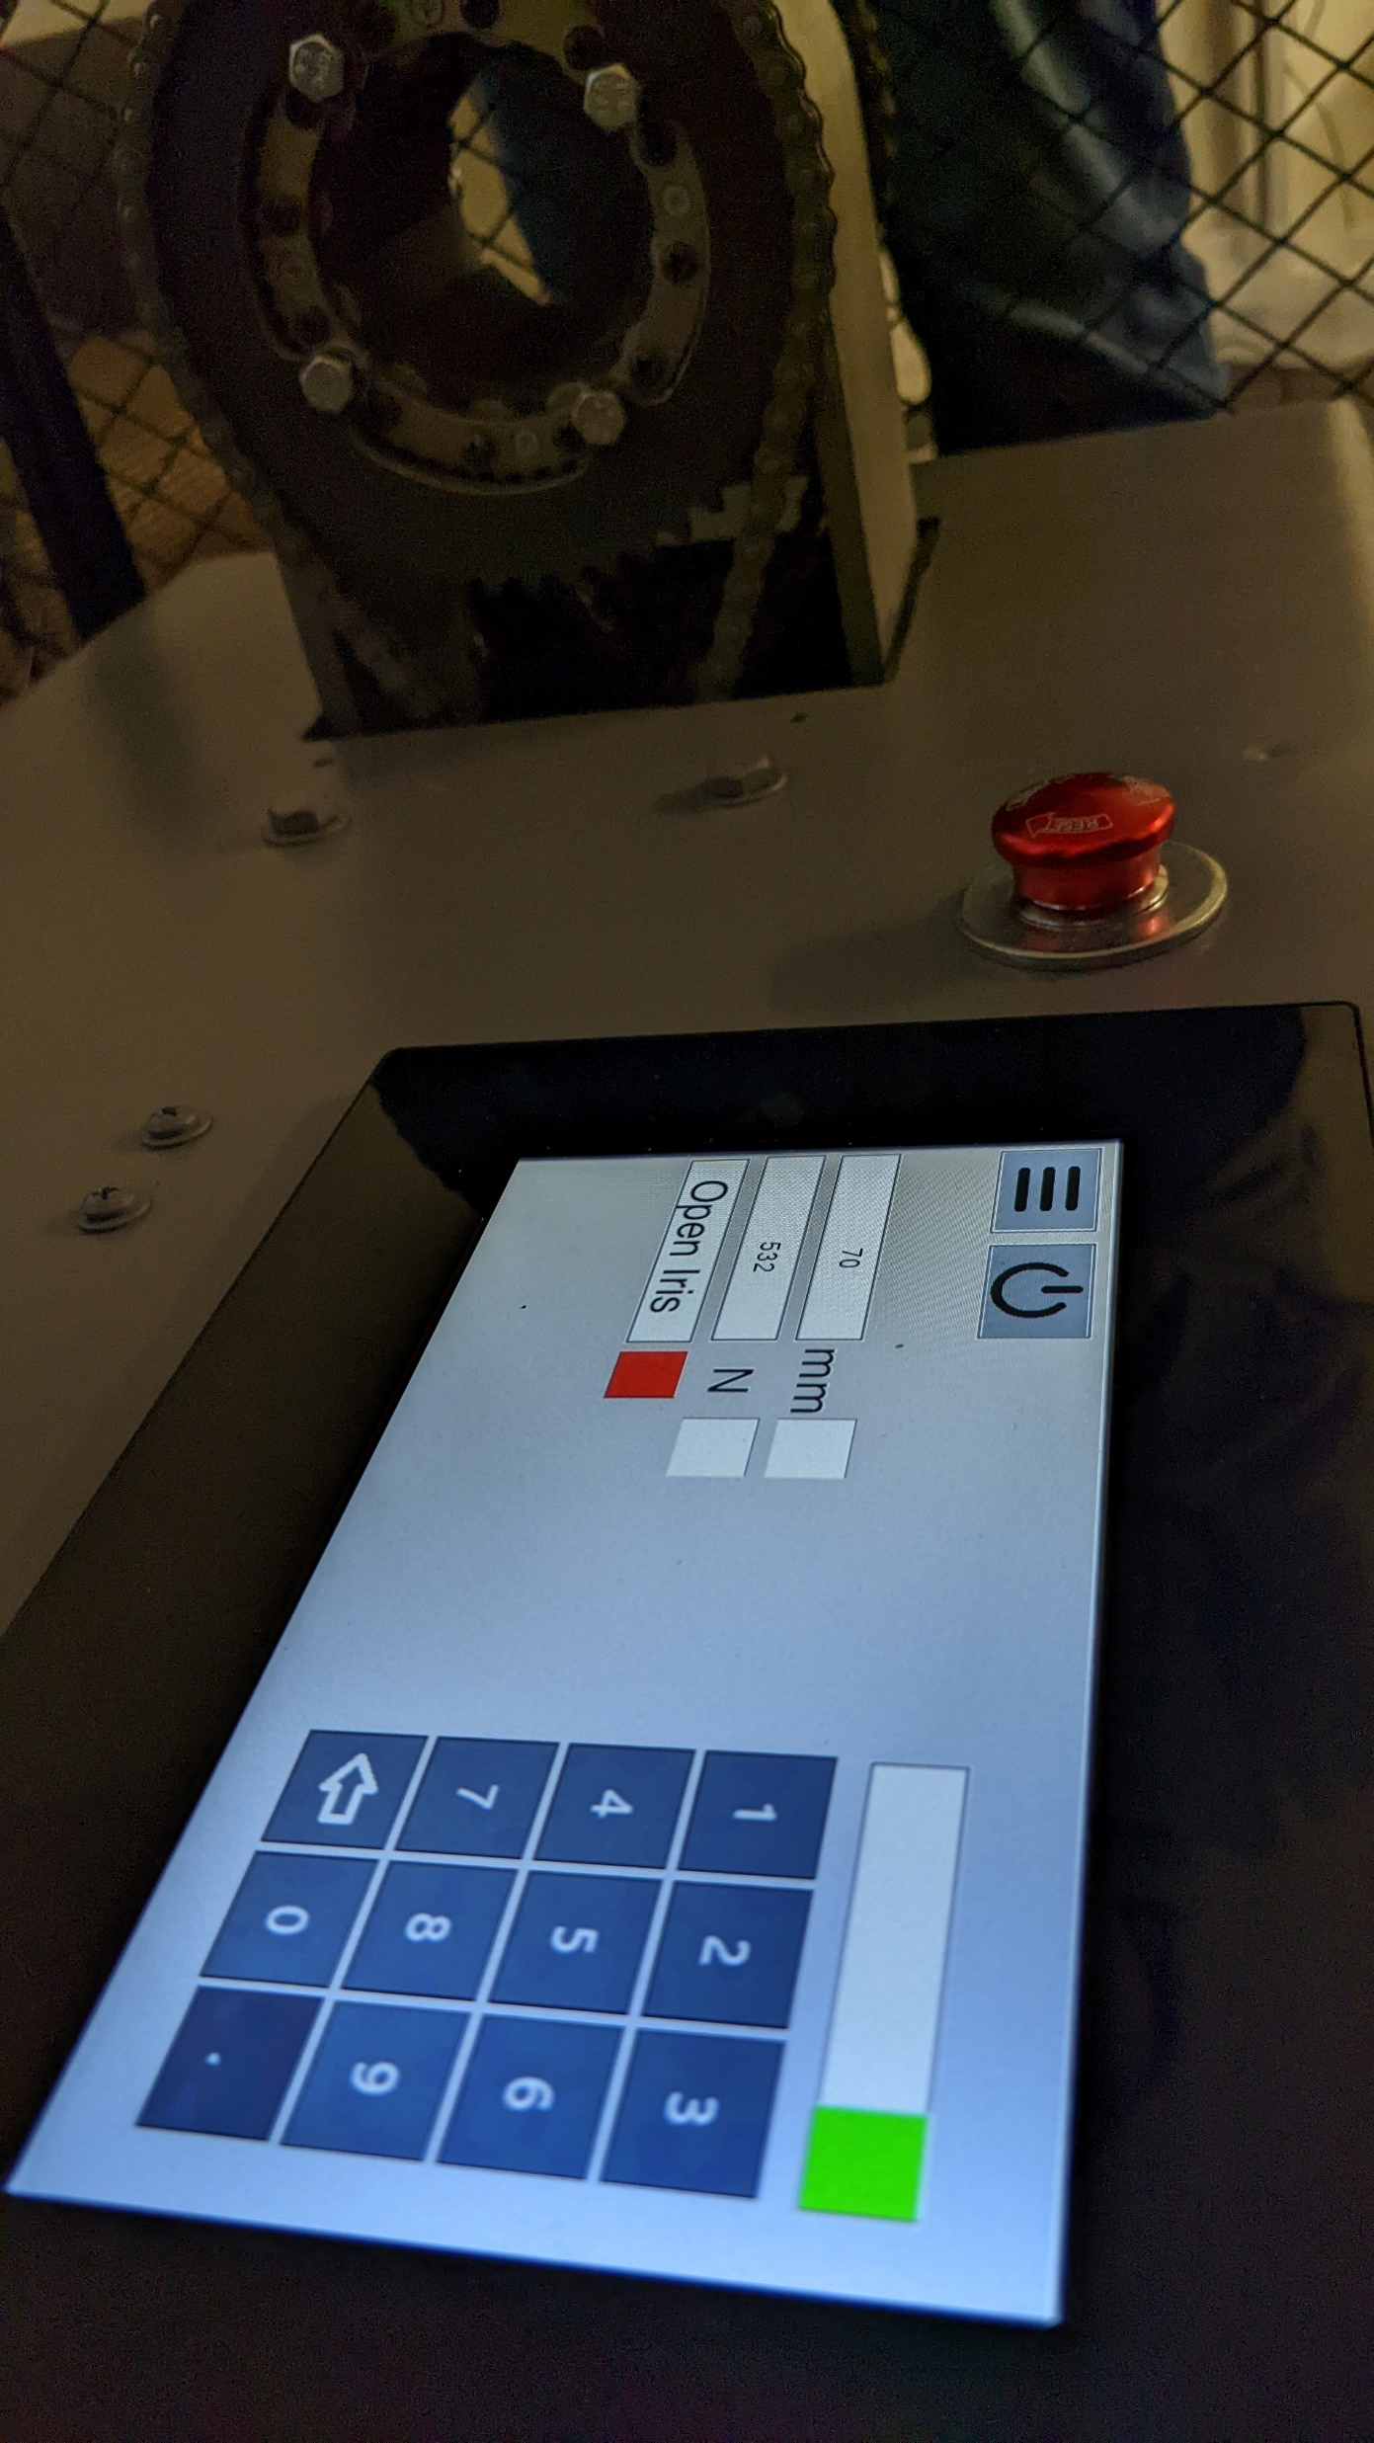
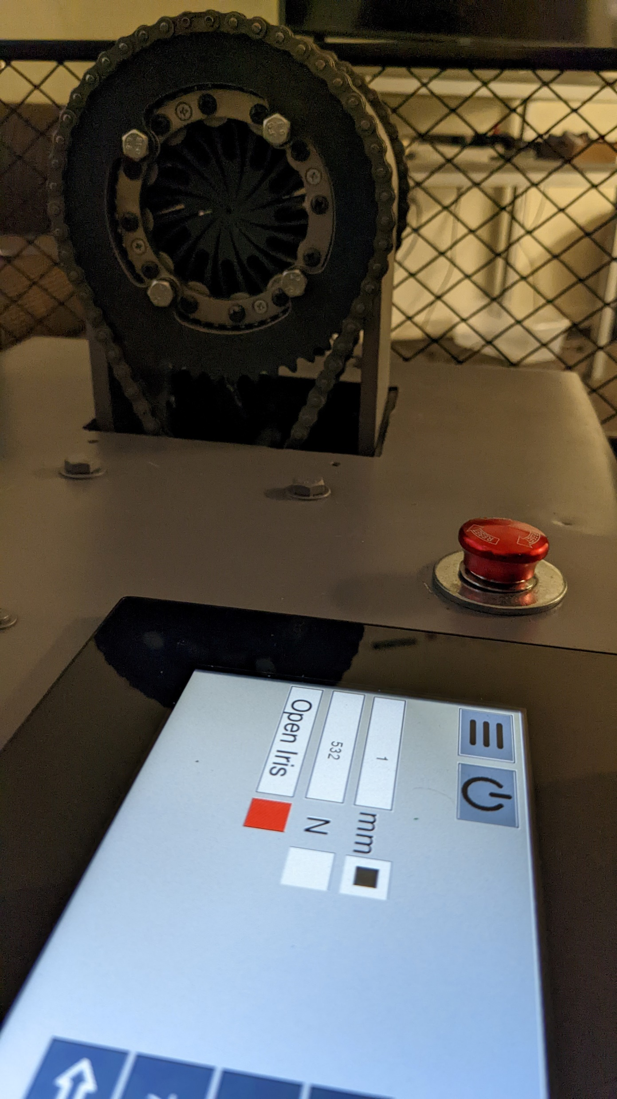
Diameter Calibration Test

Slide 7
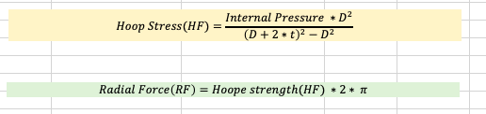
FSR 406 (Force Resistive Sensor Readings)
* FSR should output a pressure when touching the stent (internal pressure)
*Convert the reading to the Radial Force to crimp

Slide 8
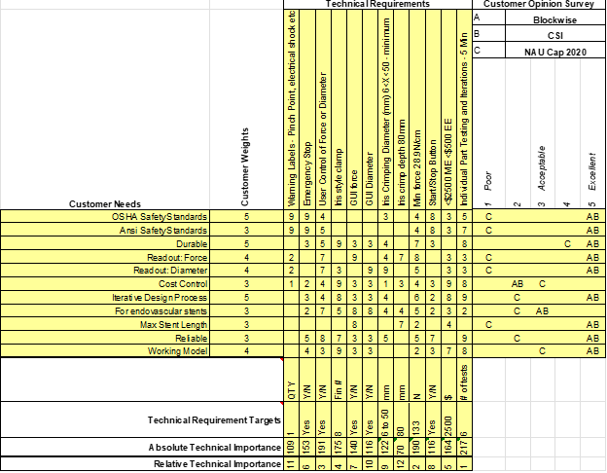
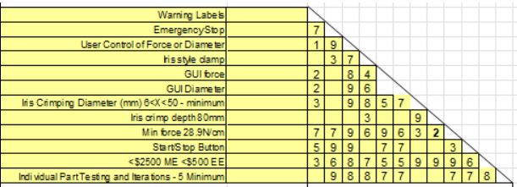
QFD

Slide 9
Questions?

